Slide 1


Practical
Data Science & Machine Learning:
Use Case Examples
BUS152
Spring 2024

Slide 2

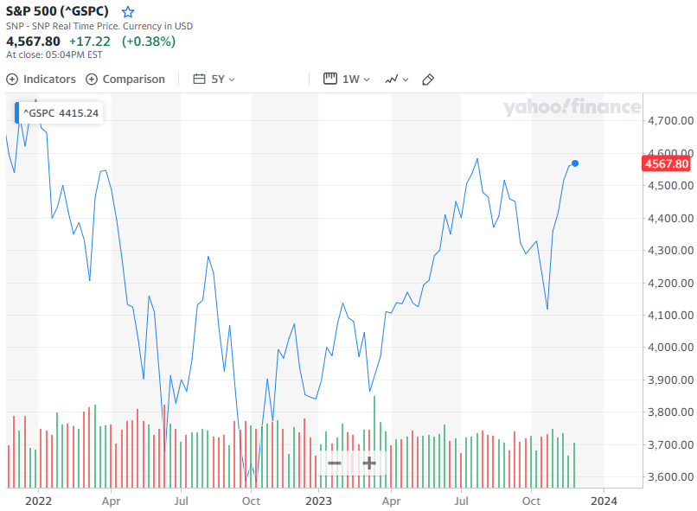
Predicting Stock Market Direction
Can you predict which direction the stock market will go tomorrow?
Classification problem

Slide 3

Forecasting Sales
Can you forecast what sales will be for your company next quarter?
Estimation problem
$
Q1
Q2
Q3
Q4

Slide 4

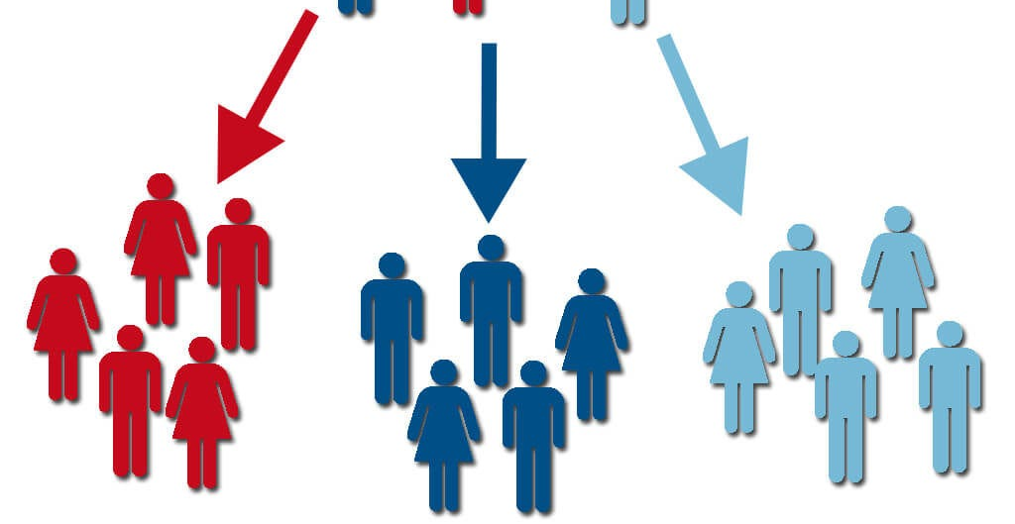
Customer Segmentation
Does segmenting our customers into groups reveal any interesting patterns of similarity/dissimilarity?
Clustering problem

Slide 5
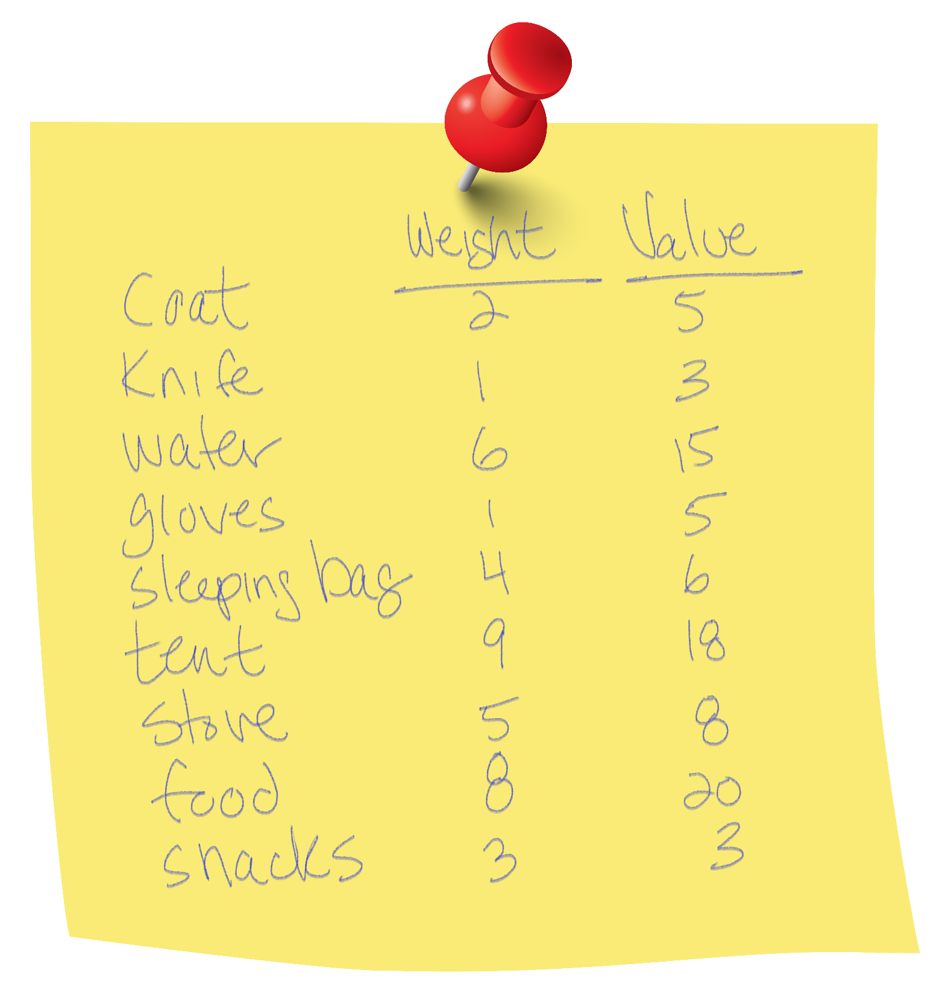
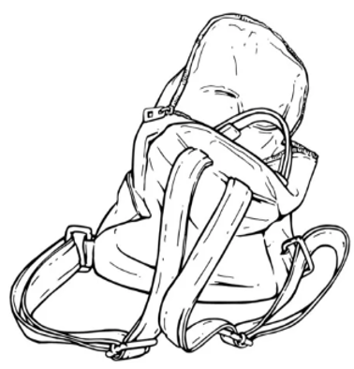
Knapsack Problem
If you can’t carry everything because of a weight limit, what’s the best combination of items to pack that will maximize your total value?
Optimization problem
25kg Max Limit!!

Slide 6
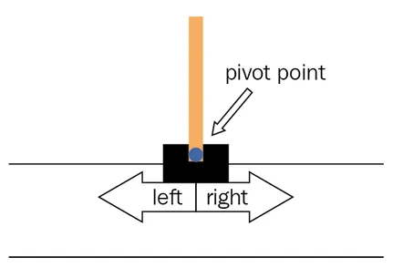
Cart Pole Balancing
Can you design a program that learns how to balance an inverted pendulum on a moving object (pole on a cart) and keep it from falling over?
Reinforcement Learning problem

